Slide 1
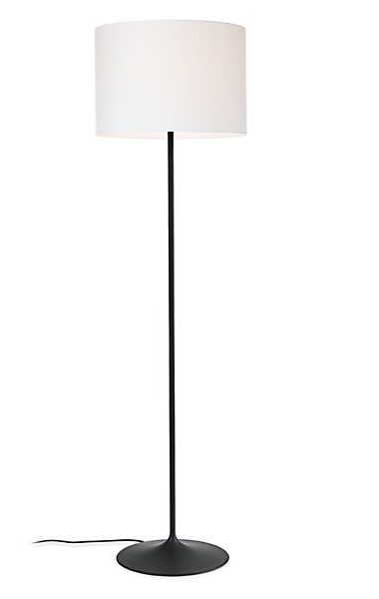
Our Fremont floor lamp has a fluid shape and a sleek, modern design. We designed the spun steel base to provide stability while reinforcing the minimal look of the lamp. A white fabric shade allows a diffuse glow and a full-range dimmer adds versatility.

Slide 2
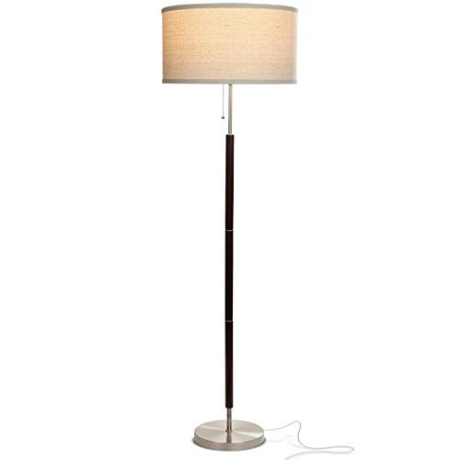
The best floor lamps should be sturdy, stylish, and bright enough to light up a room. We found the top lamps available with options for any style.

Slide 3
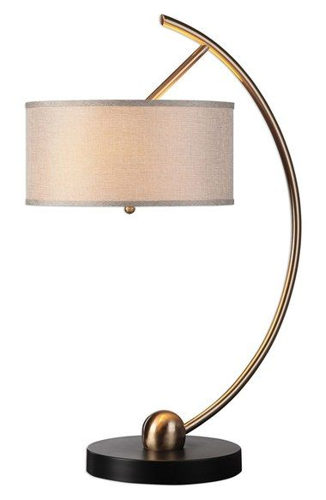
A natural linen drum shade tops an elegantly curved metal lamp finished in brushed brass and set on a matte black foot.14 1/2" lamp shade diameter; 32" overall height. 9 lbs. Metal/linen. By Domiday Exclusive Designs

Slide 4
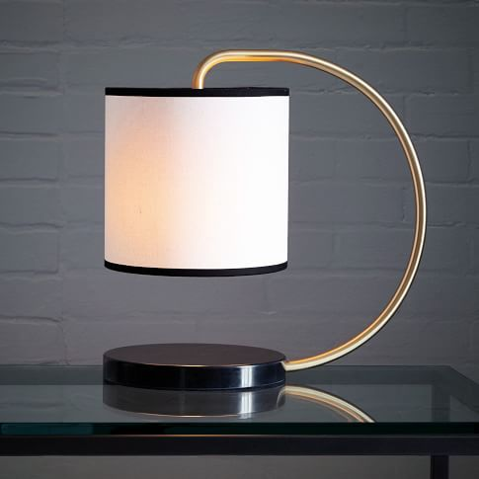
Brighten up your home with modern table lamps from Domiday Exclusive Designs. Find contemporary bedside lamps, task lamps, table lamp sets and more.

Slide 5

Umbrella standing designed by the Domiday Exclusive Designs,
This item is one of the most representative.
The umbrella stand is made with Aluminium and it has a conical shape.
The cone is held by an aluminium rod.
Good condition, fully original.

Slide 6
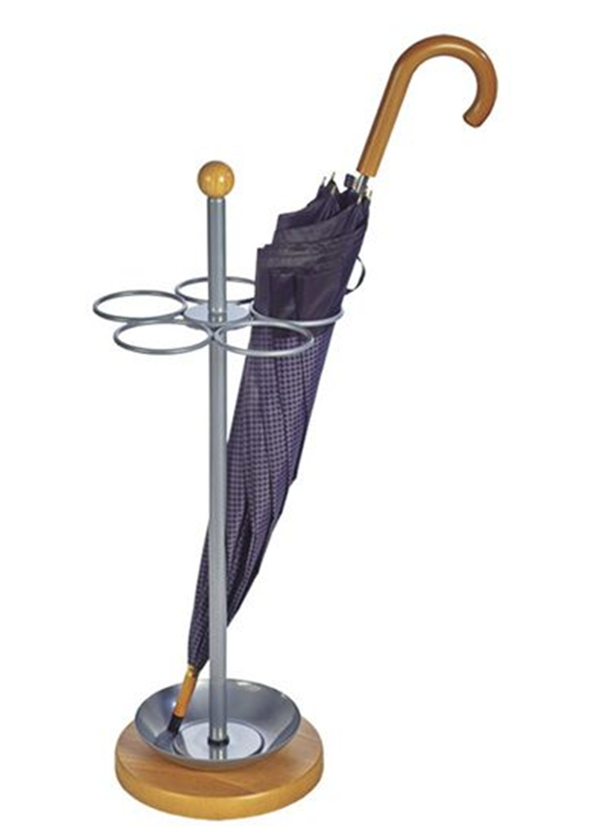
Upgrade your home with attractive modern and chic design,
keep your ground dry from wet umbrellas.
With this umbrella stand without adding clutter to your home or office

Slide 7

These Domiday exclusive designs bath wraps exclusively fulfilled. The wrap set comes In three different colours: White, black , green, grey & kaki, And each wrap with it matching hair towel. Improved stitching and stronger knit fabric. Convenient pocket, durable elastic back and button closure. Keep your hair in place and body wrap secure while you moisturize or apply make up. For home or travel, this set pampers you as if you were at a spa. Spoil yourself or someone you love. Perfect gift for any-occasion for women.

Slide 8

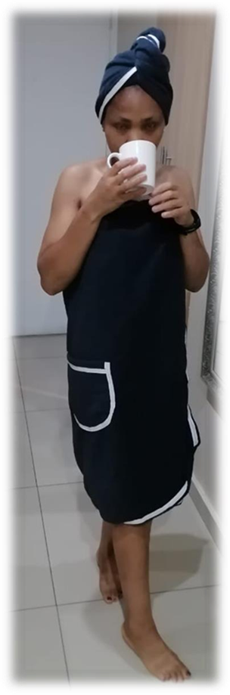
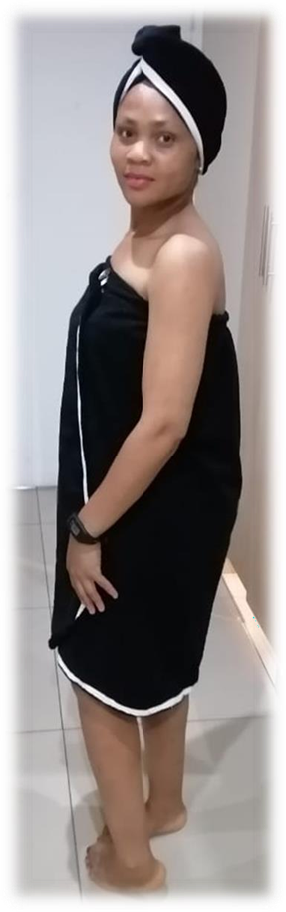


Slide 9
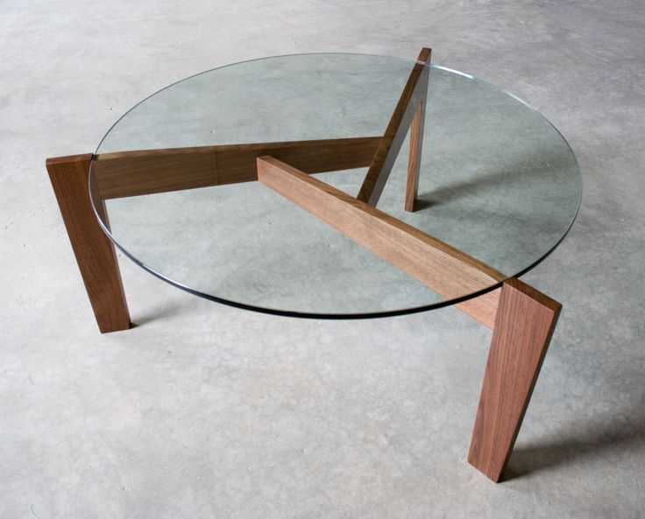
A beautiful three legged solid Walnut coffee table with a seemingly floating glass top. It will be the centre piece of any room.

Slide 10
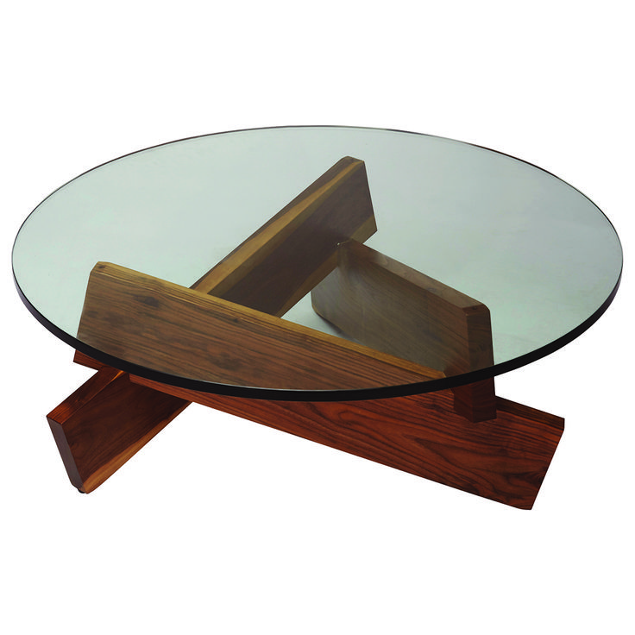
At Domiday Exclusive Designs, we offer high-end modern coffee tables, end tables, and console tables for every home. Explore our selection of luxury accent tables today.

Slide 11
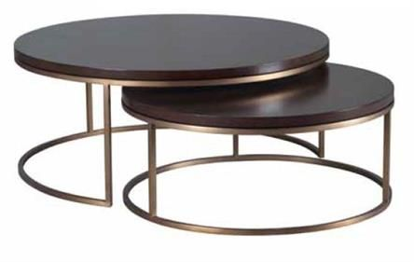

Slide 12
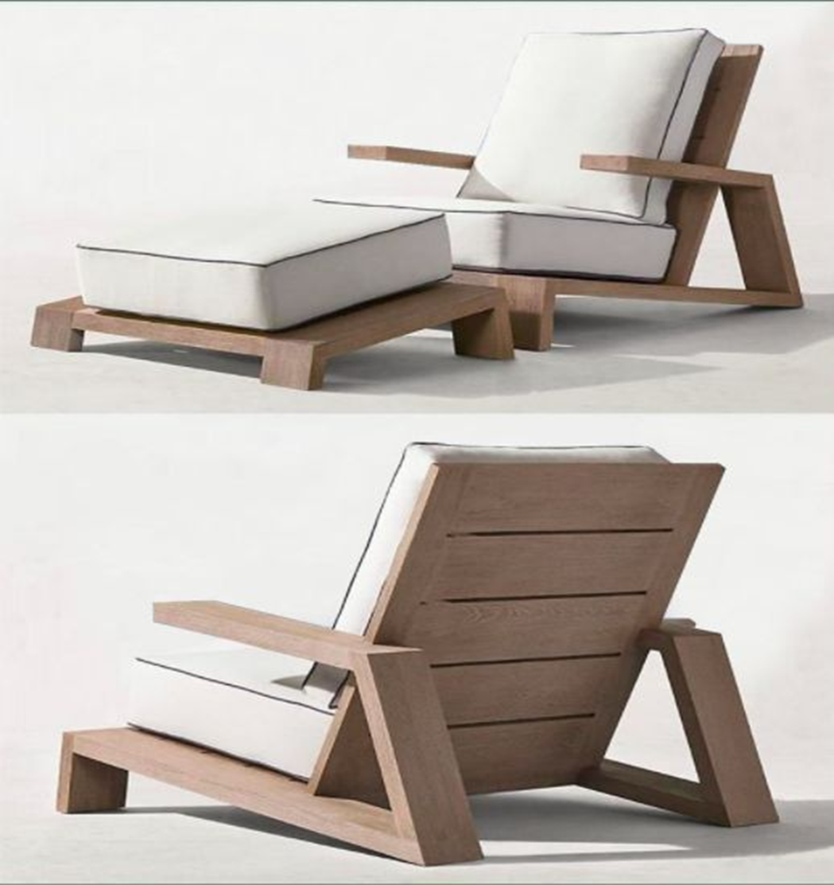
Domiday Exclusive Designs, offering furniture, lighting, textiles, bathware, decor, and outdoor, as well as products for baby and child. Discover the season's newest designs and inspirations.

Slide 13
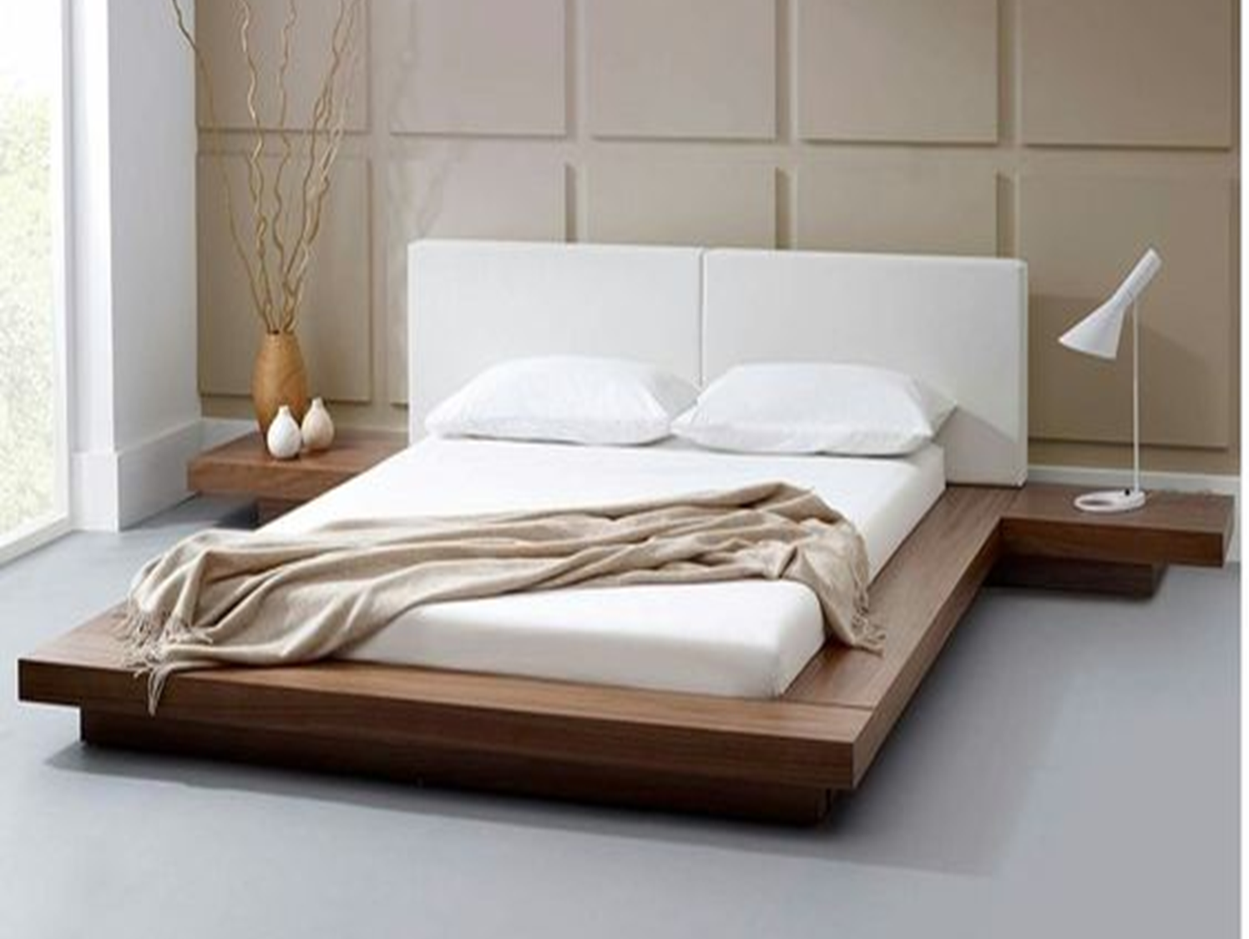
Domiday Exclusive D 6 pieces bedroom set made
with New-Zealand Pine and Birch Veneers
This set will make your bedroom a
Haven of comfort and beauty.
Three sizes:
Double
Queen size
King size
Sets of beds comes with
Mattress
2 beds pedestals
room table & mirror & ottoman

Slide 14
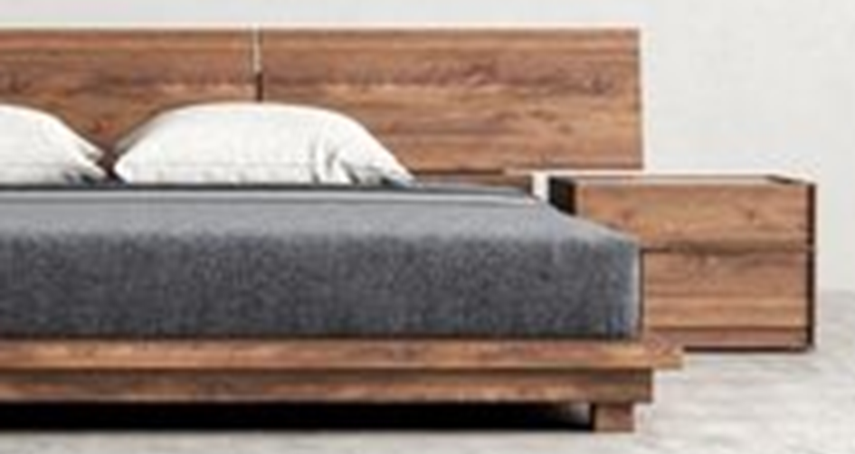
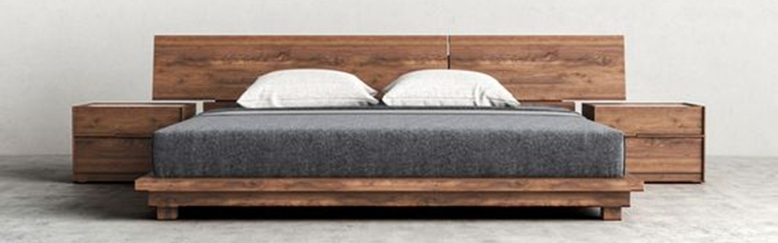
Domiday Exclusive D 6 pieces bedroom set made
with New-Zealand Pine and Birch Veneers
This set will make your bedroom a
Haven of comfort and beauty.
Three sizes:
Double
Queen size
King size
Sets of beds comes with
Mattress
2 beds pedestals
room table & mirror & ottoman

Slide 15
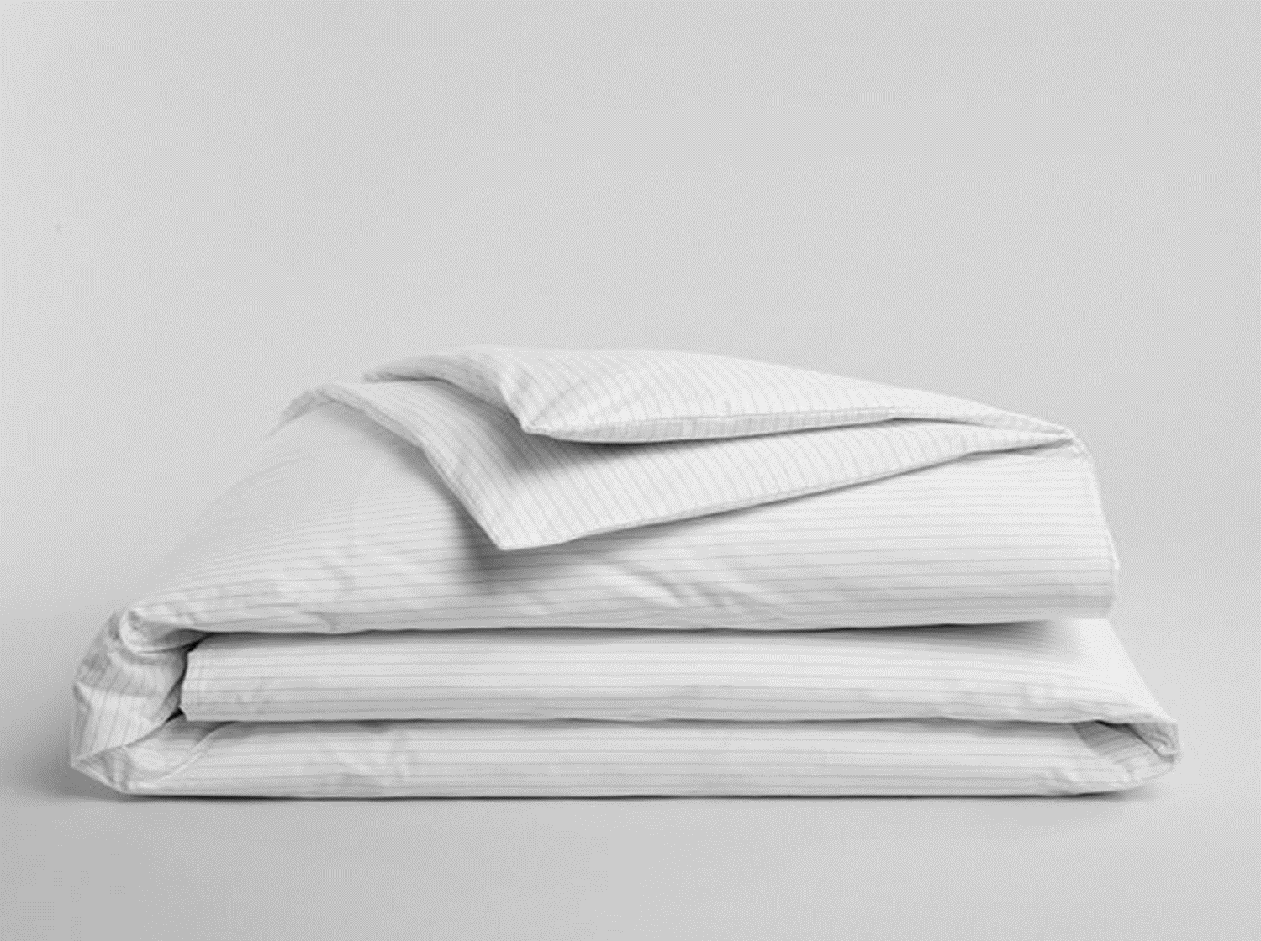
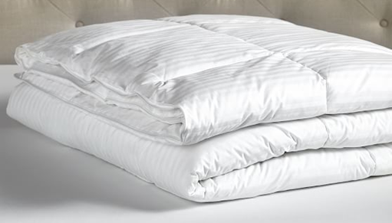
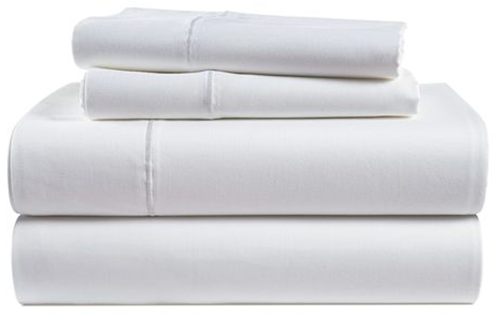
Bed-cover & pillow cases
Domiday Exclusive Designs 100% Cotton bedding is a must-have for every bed. They’re woven with fine single yarns for an unbelievably smooth hand. Offered in a wide selection of solid hues from chic neutrals to seasonal favorites. Exclusively by The Company Store. Color: White.
Comes with:
1 x duvet cover
1 x duvet inner-
1 x Fitted Sheet
1 x Cover sheet
1 x mattress protector (waterproof)
2 x sets pillow case

